Slide 1
The Modern way of Data Management Architecture and Project Experience
Ralph Kemperdick, Microsoft Deutschland GmbH
Data Platform Specialist
06/1/2014

Slide 2
Agenda
The Modern Data Warehouse
Solutions across on premise and cloud
Experiences in real world projects
What is the Hadoop Ecosystem?
New Insight and challenges
APS - Modern Data Warehouse Appliance
Deep integration with Hadoop
flexible development
unified management
common identity
integrated virtualization
complete data platform

Slide 3
Modern Data Warehouse

Slide 4
Gain knowledge of all your existing data Enrich and optimize your data from non-traditional sources
A city wanted better insights into service effectiveness. They improved services by using social, service logs, devices and GPS to improve safety and enhance services and community.
A building management company wanted to integrate and analyze data from sensors and equipment to improve efficiency and lower energy costs by 20%.
A technical university needed on-demand computing in the cloud for DNA sequencing to accelerate access, discovery, and analysis.
Social and web analytics
Live data feeds
Advanced analytics

Slide 5


The traditional data warehouse
BI and analytics
Dashboards
Reporting
… data warehousing has reached the most significant tipping point since its inception. The biggest, possibly most elaborate data management system in IT is changing.
– Gartner, “The State of Data Warehousing in 2012”
Data warehouse
ETL
Data sources
OLTP
ERP
CRM
LOB

Slide 6
The traditional data warehouse
BI and analytics
2
Real-time
data
Dashboards
Reporting
Data warehouse
ETL
1
3
4
Increasing
data volumes
New data
sources & types
Cloud-born
data
Data sources
Non-Relational Data
OLTP
ERP
CRM
LOB
Devices
Web
Sensors
Social

Slide 7


The modern data warehouse
BI & ANALYTICS
Self-service
Corporate
Collaboration
Mobile
Predictive
DATA ENRICHMENT AND FEDERATED QUERY
Single query model
Extract, transform, load
Data quality
Master data management
DATA MANAGEMENT & PROCESSING
✓
Relational
Non-relational
Analytical
Streaming
Internal & External
INFRASTRUCTURE
Data sources
Non-relational data
OLTP
ERP
CRM
LOB
Devices
Web
Sensors
Social

Slide 8

Freedom of deployment options and hybrid solutions
Box Software
Appliances
Cloud
SQL Server
Analytical Platform System =
Parallel Data Warehouse +
HDInsight on Appliance
SQL Server for data warehousing in Windows Azure VMs
SQL Server Fast Track
HDInsight for Windows Azure
Hortonworks Data Platform

Slide 9
Real life experience with Parallel Data Warehouse

Slide 10
Client Requirement
Future proof
Minimization
Simplify
Replace existing Oracle based Data Warehouse
Provide enough resources to fulfill the needs for the next couple years
Stable, reliable and simple to use, known technology
Reduction of cost for licensing and maintenance
Keep configuration, installation and administration to a minimum
Provide scalability with as little effort as possible
Appliance provides everything necessary for an immediate start
Consolidate business data from different systems
Provide “Single Version of Truth” to the whole company

Slide 11
Migration – From Fasttrack to PDW
Adapt existing data model, Integration Services and Analysis Services Processes
Easy deployment of existing Kimball based data model to PDW
Change ETL configuration to PDW
Configure Cube to use PDW
Improvements
Boost transfer rates by ~65% from 25Gbit to 40Gbit
Enhance daily provision by ~ 70% from 6h down to 3,5h
11

Slide 12
Cube Processing
Lower values are better.
12

Slide 13
Cube Processing
Instant benefits
Significant improvement while processing due to parallel execution
Up to 8x as many queries compared to the old infrastructure
No influence on existing or upcoming processes
Further Options
Change cube design to ROLAP / HOLAP instead of MOLAP
Extend network bandwidth for more throughput
13

Slide 14
Ad Hoc Queries
14

Slide 15
Other improvements
Change several transformations from ETL (SSIS) to ELT (CTAS).
Decision has to be made on business logic and complexity
Best improvement from 70 minutes down to 5 minutes
Window Functions supply great functionality
15

Slide 16
What is the HADOOP Ecosystem?

Slide 17
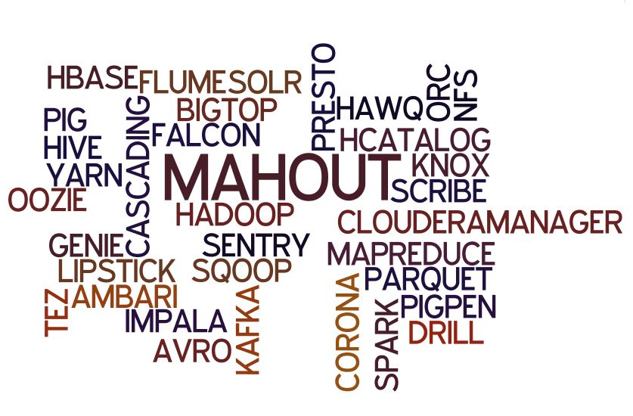
Hadoop technologies
Source: Subash D’Souza, Hadoop Innovation Summit 2014

Slide 18

Challenges
Data Protection
Security
SLA’s – Service Level Agreements
Integration w/ applications
Services and support
Training
Performance
Scaling and Administration
Source: Subash D’Souza, Hadoop Innovation Summit 2014

Slide 19
Hadoop Technologies
Categories that matter
Realtime Steraming
Flume
Kafka
Scribe
Hbase
Security
Kerberos with ACL’s
Cloudera Sentry
Project Knox
Accumolo
HBase w/Cell Security
Developer Tools
Kite
Java M/R
Spring for Hadoop
Hive
Pig
Scalding
Impala
Others
Management, Monitoring, Scheduling
Ambari
Cloudera Manager
HUE
Mahout
Giraph
Zookeeper
Oozie
Yarn & Real-Time
Multi Tenancy
HA(High Availability)
Tools for SQL-On-Hadoop
Impala
Stinger/Tez
Drill
Shark
Source: Subash D’Souza, Hadoop Innovation Summit 2014

Slide 20
What Hadoop Technologies to choose ?
The choices are huge
The toolsets are varied
What problems need to be solved?
Don’t choose Hadoop because it is hype!
Verify that there is a real need
Is the staff ready for the zoo?

Slide 21
Microsoft HDInsight
Gain the full value of your big data
Microsoft Azure
Hadoop
100% Apache-based (HDP)
Elastic scale
Management simplicity of Windows

Slide 22
Microsoft’s Modern Data Warehouse Appliance

Slide 23




Introducing the Microsoft Analytic Platform System V2 AU1 (PDW) Your turnkey modern data warehouse appliance
Enterprise-ready big data
Next-generation performance at scale
Engineered for optimal value
Relational and non-relational data in a single appliance
Enterprise-ready Hadoop
Integrated querying across Hadoop and PDW using T-SQL
Near real-time performance with In-Memory
Scale-out to accommodate your growing data
Industry’s lowest DW price/TB
Value through a single appliance solution
Value with flexible hardware options using commodity hardware

Slide 24
We deliver enterprise-ready Hadoop with HDInsight Manageable, secured and highly available Hadoop integrated into the appliance
SQL Server
Parallel Data
Warehouse
High performance tuned within the appliance
Secured cluster with end-user authentication
PolyBase
Microsoft HDInsight
100% Apache Hadoop
Managed and monitored using System Center
Accessible insights for everyone with Microsoft BI tools

Slide 25
Scaling out your data to petabytes
Scale-out
Scale units are groups of nodes with dedicated CPU, memory, and storage
Incrementally add hardware for near-linear scale (both PDW and HDInsight)
Handles query complexity and concurrency at scale
PDW / HDInsight
PDW / HDInsight
PDW / HDInsight
PDW / HDInsight
PDW / HDInsight
PDW / HDInsight
PDW
0TB
∞ PB
25

Slide 26
Connecting islands of data with PolyBase Bringing Hadoop point solutions and the data warehouse together for users and IT
Hortonworks
Windows Server
Select…
Result set
Single T-SQL query model for PDW and Hadoop
Rich features of T-SQL including joins without ETL
Enhance query execution performance using the power of massively parallel processing
Open and collaborative platform
Supports Microsoft Azure HDInsight to enable new hybrid cloud scenarios
Query non-Microsoft Hadoop distributions such as Hortonworks and Cloudera
SQL Server
Parallel Data
Warehouse
Microsoft Azure
HDInsight
Cloudera
Hortonworks Linux
PolyBase
Microsoft HDInsight

Slide 27
Use cases where PolyBase simplifies using Hadoop data
High performance queries against Hadoop data
Archiving warehouse data to Hadoop (move)
Exporting relational data to Hadoop (copy)
Importing Hadoop data into data warehouse (copy)

Slide 28
Let’s dive deeper… … how does it work?

Slide 29

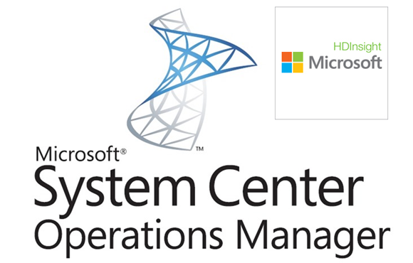
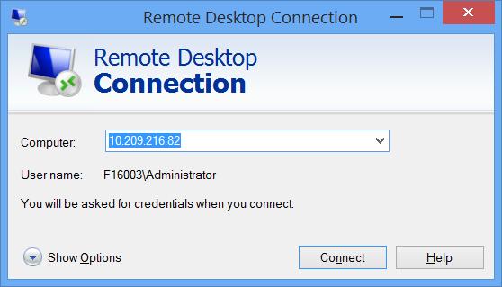
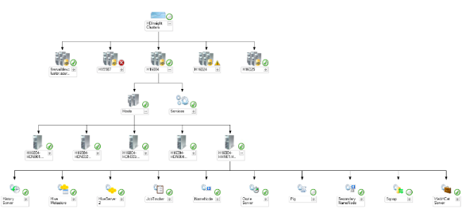
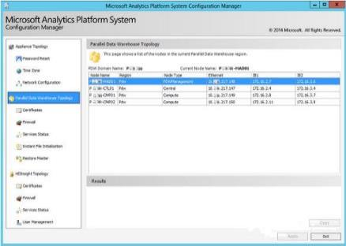
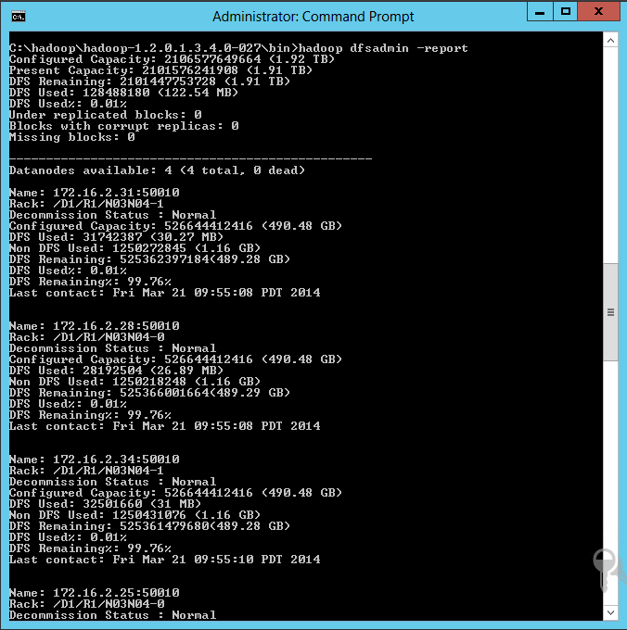
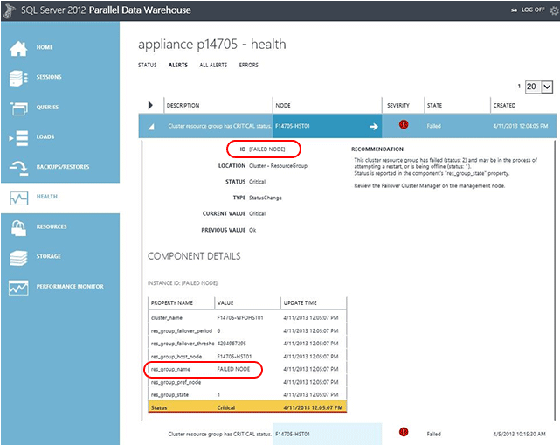
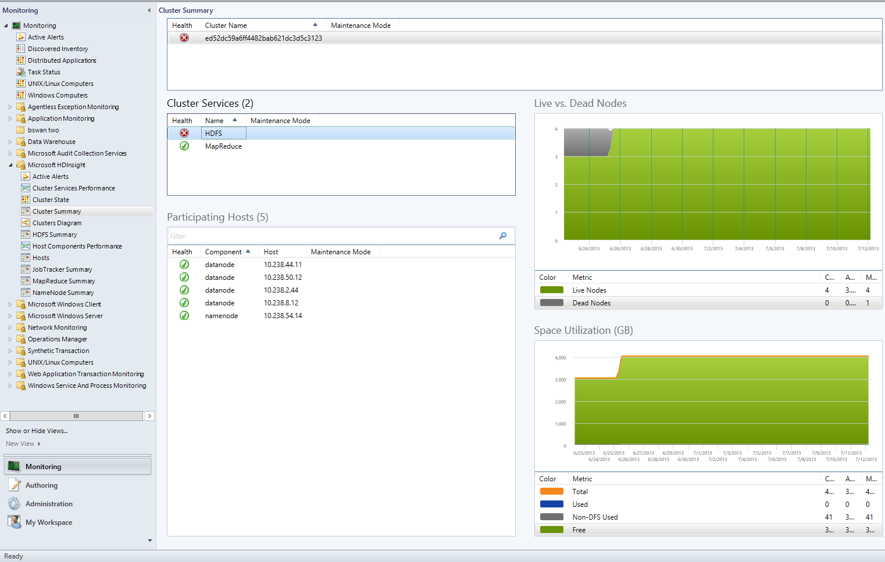
Monitoring & management
Manage corp. security
Management tools
Appliance admin
Corpnet admin
PDW
Centralized and consistent monitoring and management tools for the appliance
Firewall & network, user accounts
HW & services health, storage, jobs
System Center Operation Manager used through the PDW and HDInsight management packs (downloadable)
Native Hadoop cluster administration (through Remote Desktop and command line tools)
PolyBase
HDInsight

Slide 30
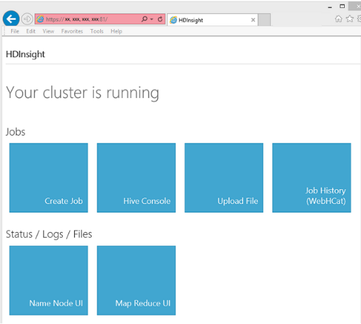
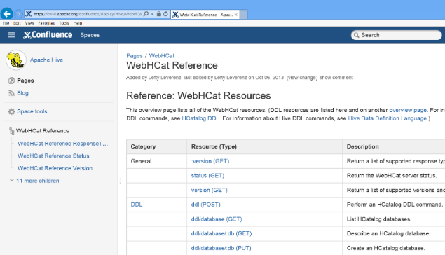
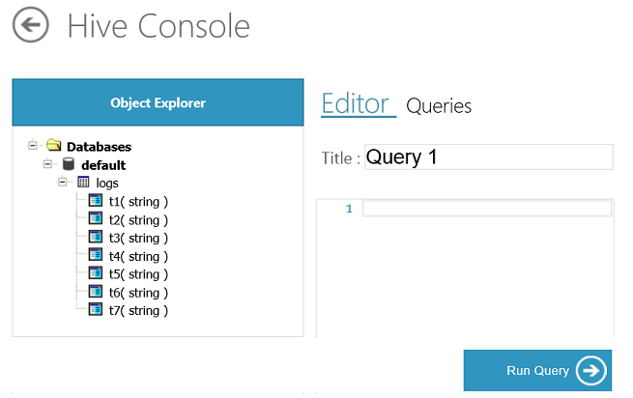
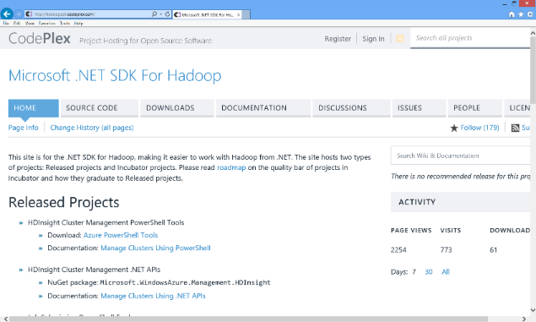


Loading and curating Big Data
Operationalize data loads as pull from network shares or through WebHDFS
No complex ETL upfront
Achieve Infiniband throughputs
Explore data, curate and rationalize it
Flexibility of Hadoop available through Hive & Pig, or any M/R job
PDW
PolyBase
HDInsight
Hadoop protocols
Hadoop Client
Developer

Slide 31

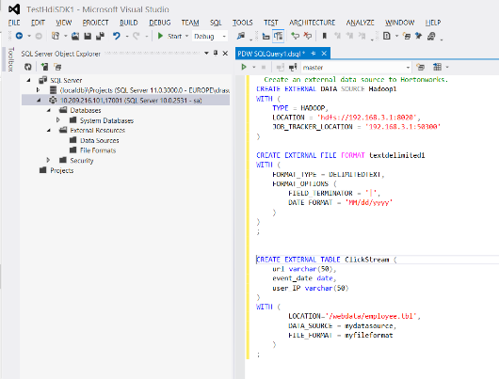
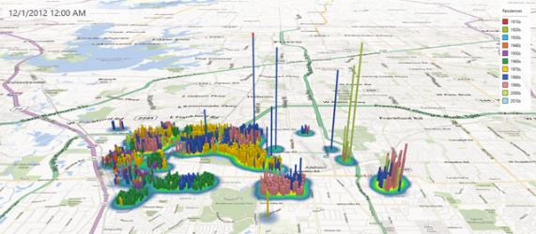
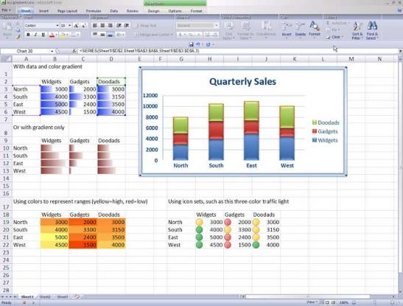
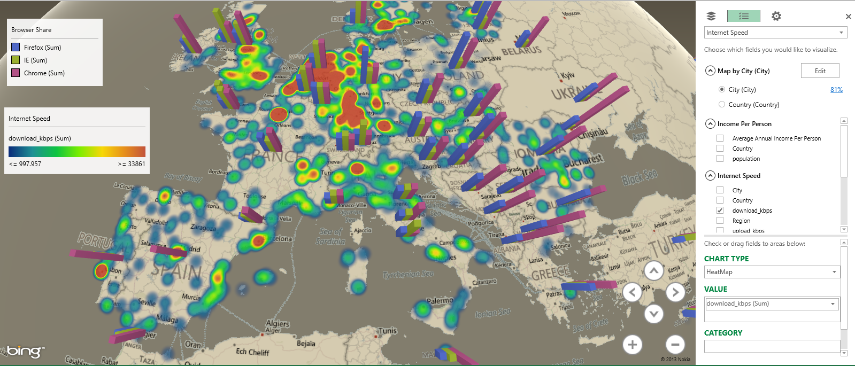
Querying all data
PDW Client
Developer
SQL protocols
Information worker
PDW
PolyBase makes querying Hadoop data straightforward and easy
HDFS data mapped onto external tables
Cost-based optimization
Predicate push-down through M/R
Keep using your favorite development and BI tools
SQL Server Developer Tools
Excel, Power View, Power Query, ...
PolyBase
HDInsight

Slide 32
PolyBase syntax
--Create an external table mapped to
--an HDFS location
CREATE EXTERNAL TABLE ClickStream (
url varchar(50),
event_date date,
user_IP varchar(50)
)
WITH (
LOCATION='/webdata/employee.tbl',
DATA_SOURCE = Hadoop1,
FILE_FORMAT = textdelimited1
)
;
--Query the same way as internal DW tables
SELECT * FROM ClickStream
WHERE event_date=@targetDay;
--Export data to HDFS (external table created)
USE AdventureWorksPDW2012;
CREATE EXTERNAL TABLE hdfsCustomer
WITH (
LOCATION='/pdwdata/customer.tbl',
DATA_SOURCE = customer_ds,
FILE_FORMAT = customer_ff
)
) AS SELECT * FROM dimCustomer;
--Create an external data source --(Hadoop cluster)
CREATE EXTERNAL DATA SOURCE Hadoop1
WITH (
TYPE = HADOOP,
LOCATION = 'hdfs://192.168.3.1:8020',
JOB_TRACKER_LOCATION = '192.168.3.1:50300'
);
--Create a file format definition
CREATE EXTERNAL FILE FORMAT textdelimited1
WITH (
FORMAT_TYPE = DELIMITEDTEXT,
FORMAT_OPTIONS (
FIELD_TERMINATOR = '|',
DATE_FORMAT = 'MM/dd/yyyy'
)
);

Slide 33
PolyBase query lifecycle
CREATE EXTERNAL DATA SOURCE Hadoop1 …
CREATE EXTERNAL FILE FORMAT textdelimited1…
CREATE EXTERNAL TABLE ClickStream…
CREATE STATISTICS Stats1 ON ClickStream ...
DROP STATISTICS ClickStream.Stats1
SELECT * FROM ClickStream
WHERE event_date=@targetDay;
Table stats?
DDL executed in PDW engine maps to source, format and table
Statistics gathered on external tables to be used in query optimizer (based on sampling)
On selection, query optimizer makes decisions on predicate push-down based on statistics
SQL Server PDW
Control Node
Compute
Node
Compute
Node
HDInsight
HeadNode
(HDFS/MapReduce)
DataNode
DataNode
DataNode
DataNode
DataNode
DataNode

Slide 34






Solution Architecture – Hybrid Scenarios
Polybase as key integrative feature
Integration with external Hadoop, HDInsight region & Azure Storage
Data aging strategies
Aging of cold data to Azure Storage
APS & HDInsight region for hot & warm data
Query hot data & cold aged data
APS as modern cloud end-point for Azure
Seamless querying of hot & cold data through APS
APS as gateway allowing users to query all on-prem data via PowerBI and
Microsoft Azure
Your Apps
Azure HDInsight
Azure Storage
Azure Express Route
Public Internet
T-SQL examples
On-premises or
“private cloud”
Your Apps
Microsoft APS Polybase
CREATE EXTERNAL DATA SOURCE WASB WITH (TYPE = Hadoop,
LOCATION = ‘wasbs://dailylogs@myaccount.blob.core.windows.net’);
Microsoft or 3rd party Applications
APS control & data nodes
CREATE EXTERNAL TABLE clickstream_HDInsights (url varchar(50), event_date date) WITH (DATA_SOURCE = WASB, LOCATION =‘/input/ log1.txt’,FILE_FORMAT = MyDelimitedText);
SELECT FROM clickstream_HDInsights, PDW_Table

Slide 35
Conclusions

Slide 36
Key Takeaways
Hadoop enables new insights but also brings new challenges
Microsoft deeply integrates Hadoop with your data warehouse
Microsoft provides all the benefits of an Hadoop Appliance
Enterprise class Management and Security extended to Hadoop
Microsoft uniquely offers solutions across on premise and cloud

Slide 37


Vielen Dank
Fragen?
Ralph.Kemperdick@Microsoft.com
© 2014 Microsoft Corporation. All rights reserved. Microsoft, Windows, Windows Vista and other product names are or may be registered trademarks and/or trademarks in the U.S. and/or other countries.
The information herein is for informational purposes only and represents the current view of Microsoft Corporation as of the date of this presentation. Because Microsoft must respond to changing market conditions, it should not be interpreted to be a commitment on the part of Microsoft, and Microsoft cannot guarantee the accuracy of any information provided after the date of this presentation. MICROSOFT MAKES NO WARRANTIES, EXPRESS, IMPLIED OR STATUTORY, AS TO THE INFORMATION IN THIS PRESENTATION.

